Slide 1
Fits and Tolerances
Notes:
*TWO PART LECTURE
Objectives:Tolerancing, Control of Variability - At the end of the session, students should be able to:
Define tolerance in engineering design
Recognize the different forms in which tolerances are expressed
Calculate tolerances for single parts
Identify types of fits and calculate tolerances/allowances in a multipart hole-shaft system
Allocate 30-minutes for Single Parts System and 10 minutes for More than Two Parts Systems
Note to all instructors:
It could be emphasized that tolerances apply to all engineering disciplines – not just dimensions of drawings; examples are tolerances in resistances.
This chapter is an introduction to tolerances in general with engineering drawings as examples; if you use examples of tolerances in other engineering disciplines, please notify the College of Eng, so that it could be incorporated for future classes

Slide 2
Lecture Objectives
Understand principles of Tolerances
Introduction to Fits
More than Two Parts Systems

Slide 3
Tolerance
Tolerance is the total amount a dimension may vary. It is the difference between the maximum and minimum limits.
Ways to Express:
Direct limits or as tolerance limits applied to a dimension
Geometric tolerances
A general tolerance note in title block
Notes referring to specific conditions
Notes:
A dimension is a single number. It is not possible to cut an object exactly the length specified in the dimension, and often, it is not necessary to be very precise in the cutting. Using precision equipment is very expensive, so if the cut does not have to be precise, the engineering should specify that. It will save time and money.
The person designing an object will indicate the upper and lower limits on each dimension so the machinist will know how precisely to cut the object. The tolerance is the upper limit minus the lower limit. The tolerance can be specified by giving two numbers, the upper limit and the lower limit, in the place where the dimension would normally be. It can be specified by writing, for example, 2.00 +/- .01. If the tolerance is the same for every dimension on the object, the tolerance can be specified in a note such as GEN. TOL.  .02. Such a note often appears in the title block.

Slide 4
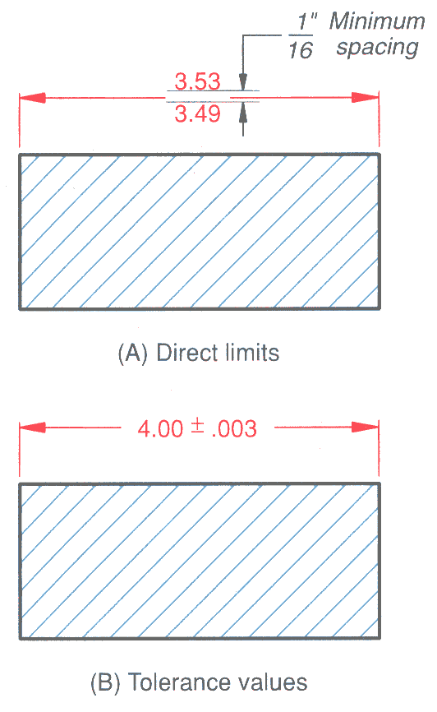
Direct limits and tolerance values
Notes:
Limits of a dimension or the tolerance values are specified directly with the dimension.

Slide 5
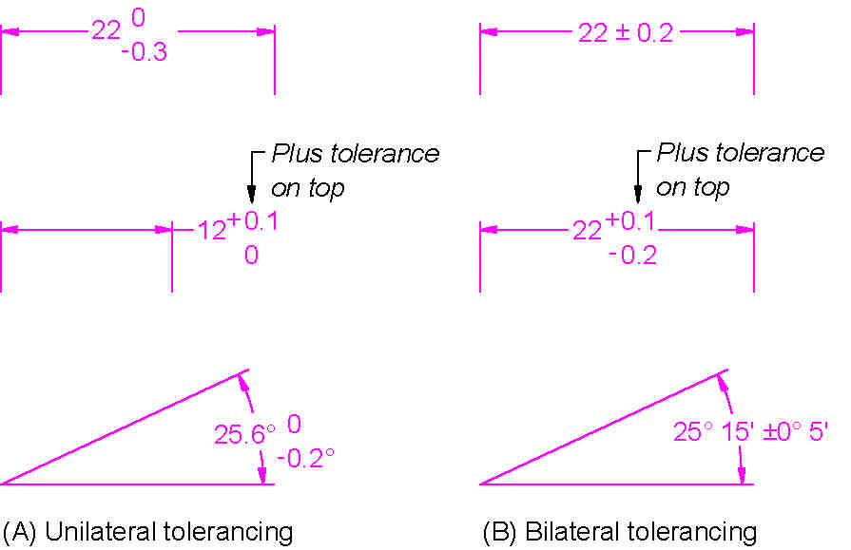
Direct limits and tolerance values – Plus and Minus Dimensions
Notes:
Unilateral Dimensions vary only in one direction; Bilateral dimension vary in both dimensions

Slide 6
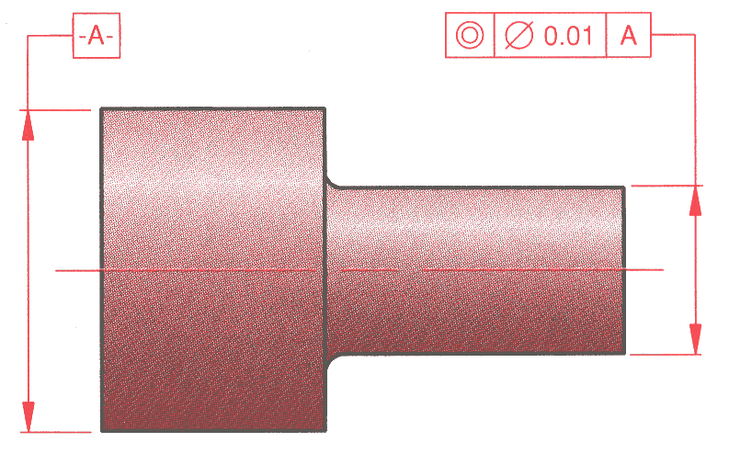
Geometric Tolerance System
Geometric dimensioning and tolerance (GD&T) is a method of defining parts based on how they function, using standard ANSI symbols.
Feature Control Frame
Concentricity Symbol
Notes:
Geometric dimensioning and tolerancing (GD&T) is now used frequently in industry. It is used to show how one part of an object is related to another. For example, in the figure on this slide, it is important that the cylinder with the small diameter be concentric with the cylinder with the large diameter. In other words, in order for this piece to fit properly into another piece, which perhaps is being made someplace else, the center of the small cylinder needs to be placed almost exactly in line with the center of the large cylinder. We need a way to indicate how much distance can be tolerated between the center of the large cylinder and the center of the small cylinder. This information is given in the feature control frame which has 3 boxes. The first box on the left indicates that the feature being controlled is concentricity. The middle box indicates how far apart the centers of the two circles can be – no more that 0.01. The third box indicates that A is the reference.

Slide 7
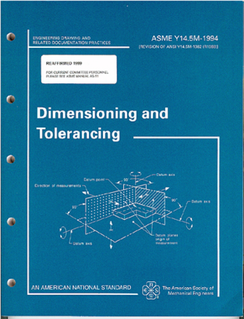
ANSI Y14.5-1994 Standard
This standard establishes uniform practices for defining and interpreting dimensions, and tolerances, and related requirements for use on engineering drawings.

Slide 8
Overview of Geometric Tolerances
Geometric tolerances define the shape of a feature as opposed to its size.
Three basic types of dimensional tolerances:
Form tolerances: straightness, circularity, flatness, cylindercity;
Orientation tolerances; perpendicularity, parallelism, angularity;
Position tolerances: position, symmetry, concentricity.

Slide 9
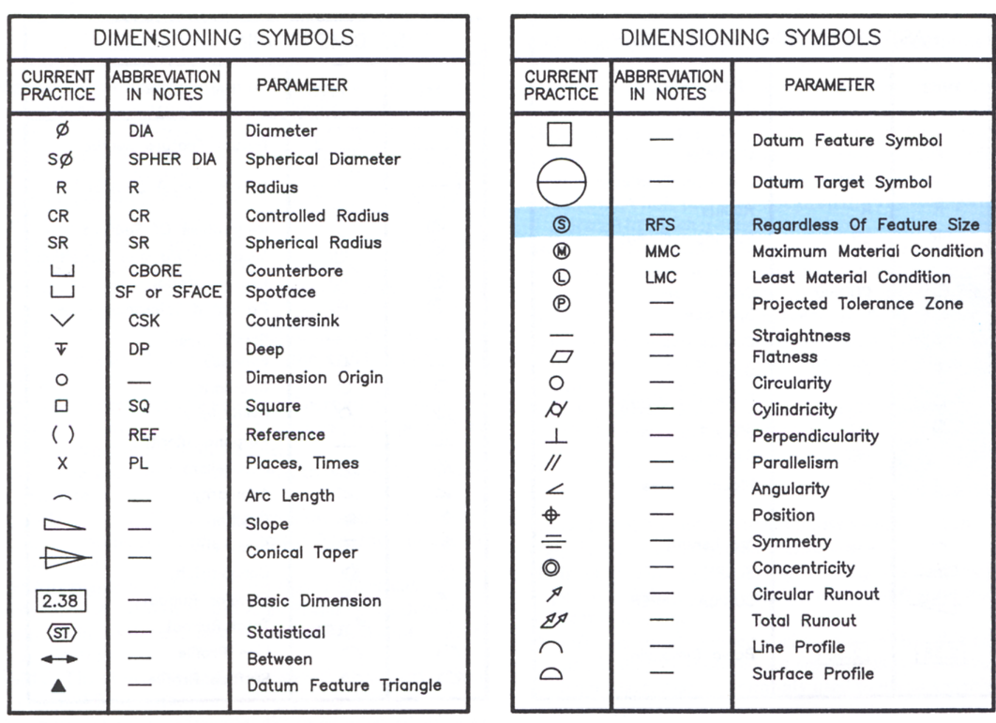
Symbols for Geometric Tolerances
Form
Orientation
Position

Slide 10
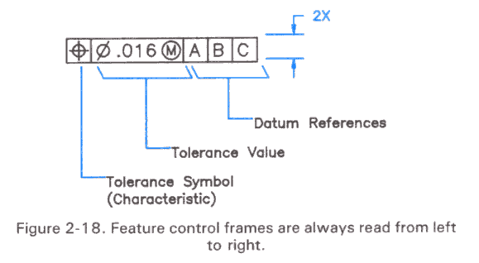
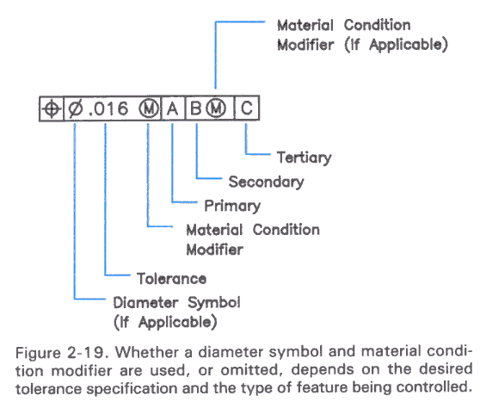
Feature Control Frame
A geometric tolerance is prescribed using a feature control frame.
It has three components:
1. the tolerance symbol,
2. the tolerance value,
3. the datum labels for the reference frame.

Slide 11
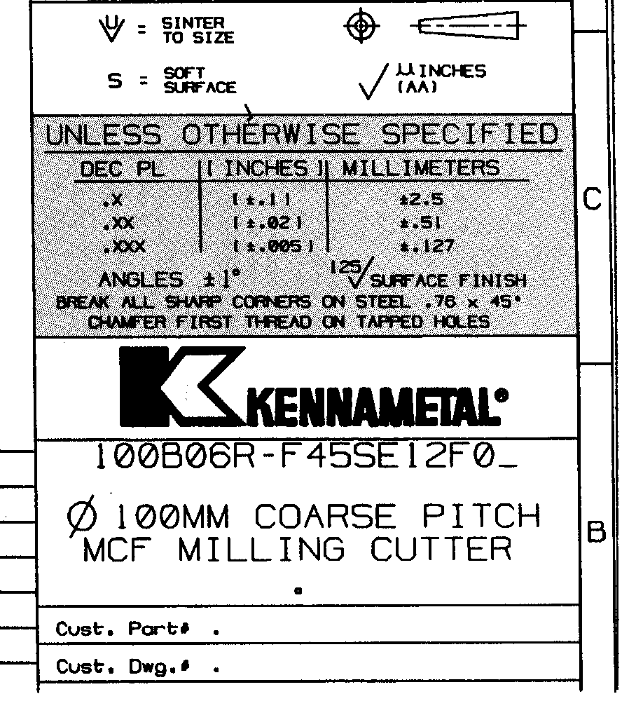
Tolerance Specifications in Title Block
General tolerance note specifies the tolerance for all unspecified tolerance dimensions.
Notes:
Discuss the circled information with the students.

Slide 12
Notes referring to specific conditions
General Tolerances could be in the form of a note similar to the one shown below:
ALL DECIMAL DIMENSIONS TO BE HELD TO ±.002”
Means that a dimension such as .500 would be assigned a tolerance of ±0.002, resulting in a upper limit of .502 and a lower limit of .498

Slide 13
Important Terms – single part
Nominal Size – general size, usually expressed in common fractions (1/2” for the slot)
Basic Size – theoretical size used as starting point (.500” for the slot)
Actual Size – measured size of the finished part (.501” for the slot)
Notes:
Note these terms apply to a single part.

Slide 14
Important Terms – single part
Limits – maximum and minimum sizes shown by tolerances (.502 and .498 – larger value is the upper limit and the smaller value is the lower limit, for the slot)
Tolerance – total allowable variance in dimensions (upper limit – lower limit) – object dimension could be as big as the upper limit or as small as the lower limit or anywhere in between

Slide 15
Important Terms – Multiple Parts
Allowance – the minimum clearance or maximum interference between parts
Fit – degree of tightness between two parts
Clearance Fit – tolerance of mating parts always leave a space
Interference Fit – tolerance of mating parts always interfere
Transition Fit – sometimes interfere, sometimes clear
Notes:
Note these terms are used with multiple parts.

Slide 16
Material Conditions
Maximum Material Condition (MMC): The condition in which a feature contains the maximum amount of material within the stated limits. e.g. minimum hole diameter, maximum shaft diameter.
Least Material Condition (LMC): The condition in which a feature contains the least amount of material within the stated limits. e.g. maximum hole diameter, minimum shaft diameter
Regardless of Feature Size (RFS): This is the default condition for all geometric tolerances. No bonus tolerances are allowed and functional gauges may not be used.

Slide 17
Holes and Tolerancing Shafts
Types of Fit
Clearance fit
The parts are toleranced such that the largest shaft is smaller than the smallest hole
The allowance is positive and greater than zero
Transition fit
The parts are toleranced such that the allowance is negative and the max. clearance is positive
The parts may be loose or forced together
Interference fit
The max. clearance is always negative
The parts must always be forced together

Slide 18
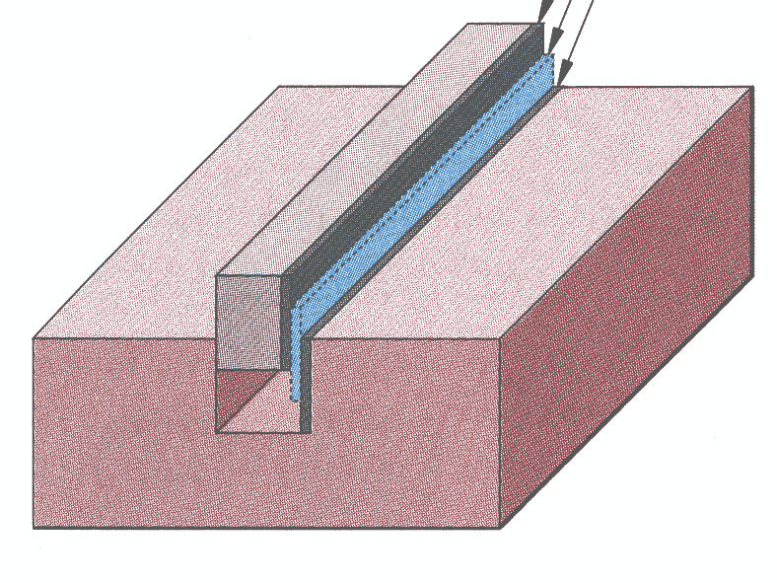
Fitting Multiple Parts
Tolerance of B
Fit Tolerance: Clearance
or interference
Part B
Tolerance of A
Part A

Slide 19
Fitting Multiple Parts
Max Clearance
0.502-0.495
Min Clearance
0.498-0.497
Notes:
Relate the drawing here to the terms defined for multiple parts in slide 11

Slide 20
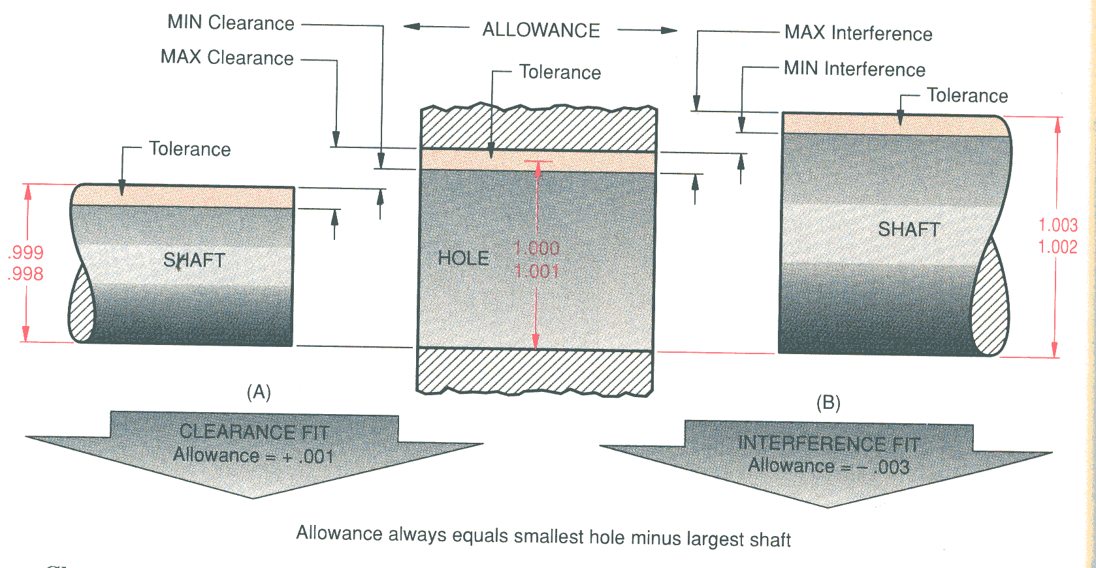
Shaft and Hole Fits
Clearance Interference
(1.00 – 0.999)
(1.00- 1.003)
Notes:
Instructor:
Here is another way to look at how parts fit together. In this illustration, the beige area represents the variation in size of one part and it is easy to see that on the left side we have a clearance fit where the smallest hole is larger than the largest shaft. This is called a clearance fit.
The opposite is true on the other end. This is a force fit, shrink fit or an interference fit.
Note the small print at the bottom: Allowance always equals the smallest hole minus the largest shaft. When you have an interference fit the allowance is negative.

Slide 21
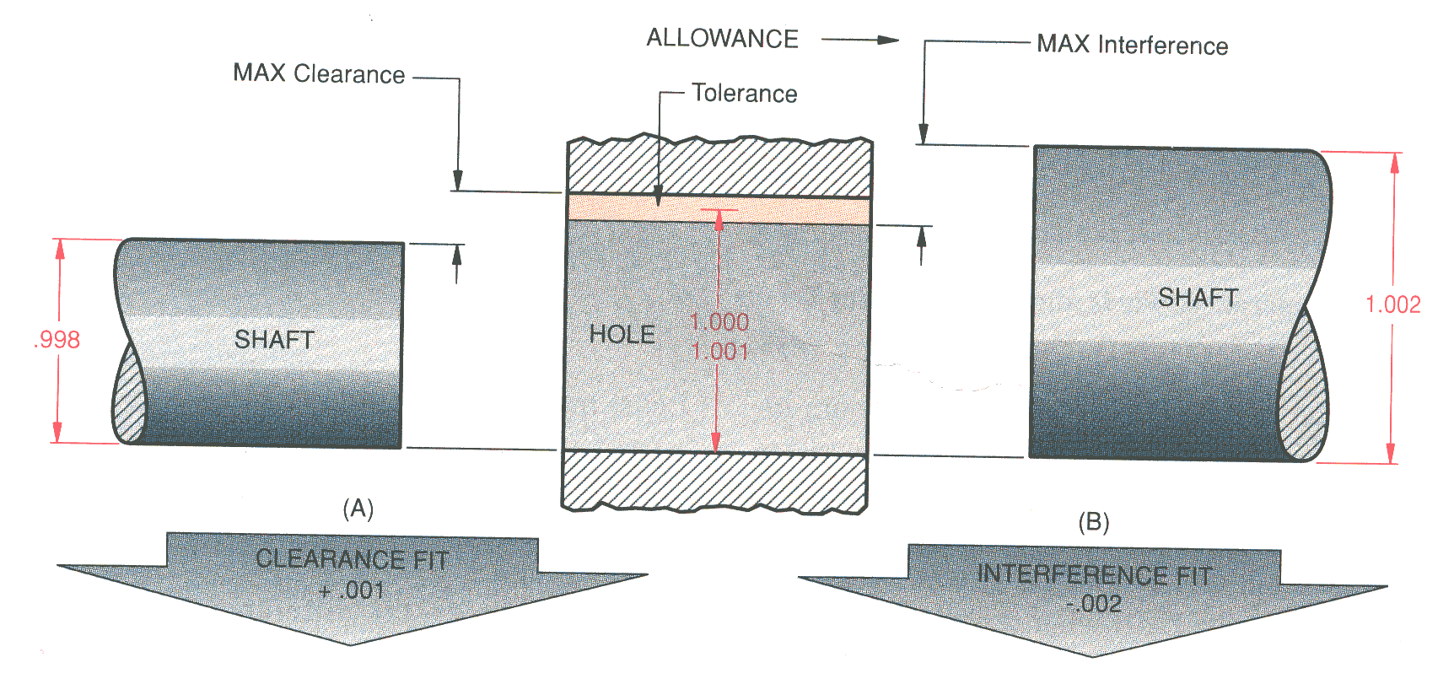
Shaft and Hole Fits
Transition
CLEARANCE FIT + .003
Notes:
Instructor:
This figure is slightly different than the previous one. Here they have put the smallest shaft on the left end and the largest shaft on the right side. The shaft on the left clears by .003 inch while the one on the right interferes by .002 inch.

Slide 22
Standard Precision Fits: English Units
Running and sliding fits (RC)
Clearance locational fits (LC)
Transition locational fits (LT)
Interference locational fits (LN)
Force and shrink fits (FN)
Notes:
Instructor:
Here are the types of fits specified by ANSI. The tables are found in the Appendices in most graphics books.

Slide 23
Basic Hole System or Hole Basis
Definition of the "Basic Hole System":
The "minimum size" of the hole is equal to the "basic size" of the fit
Example: If the nominal size of a fit is 1/2", then the minimum size of the hole in the system will be 0.500"
Notes:
Instructor:
There needs to be some order to doing tolerances and in this case the choice was to make the smallest hole the basic size. If the nominal size is given as a common fraction (1/2) then the basic size is .500 or .5000 depending on the type of fit.

Slide 24
Basic Hole System
Clearance = Hole – Shaft
Cmax = Hmax – Smin
Cmin = Hmin – Smax
Both Cmax and Cmin >0 – Clearance fit
Both Cmax and Cmin <0 – Interference fit
Cmax > 0 Cmin < 0 – Transition fit
System Tolerance = Cmax – Cmin
Allowance = Min. Clearance = Cmin
S_{MAX}
S_{MIN}
H_{MAX}
H_{MIN}
Notes:
Most common system used in dimensioning is the Basic Hole system. These are important definitions, usually showing up on exams.
See generic definitions on slide. We will do a general example and then do 1) English unit example and then metric example.

Slide 25
Basic Hole System – Example
Calculate Maximum and Minimum Clearance
Clearance = Hole – Shaft
Cmax = Hmax – Smin
.490
.485
.510
.505
Cmax = .510 - .485 = .025
Cmin = .505 - .490 = .015
Cmax > Cmin > 0 Clearance
Notes:
Cmin = Hmin – Smax
Cmin = .505 - .490 = .015
Type of Fit is Clearance
What is Cmax/ Cmin = 0??

Slide 26
Metric Limits and Fits
Note that in the Metric system:
Nominal Size = Basic Size
Example: If the nominal size is 8, then the basic size is 8
Notes:
Instructor:
In the metric system the nominal size is equal to the basic size given with the correct number of decimal places.

Slide 27
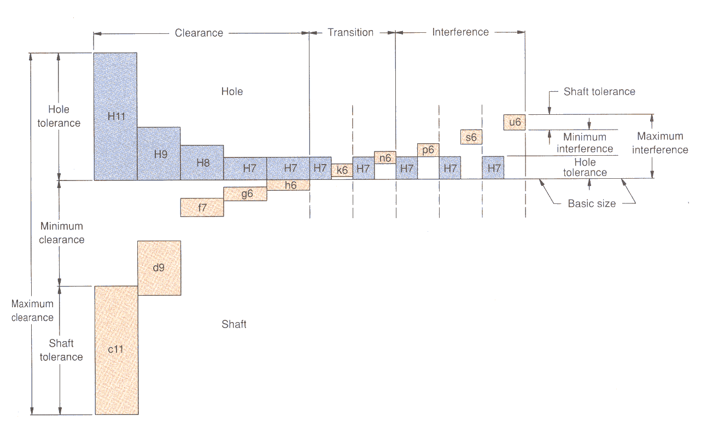
Metric Preferred Hole Basis System of Fits
Notes:
Instructor:
When working in the metric system they use a series of letters and numbers where the capital letters represent the hole and the lower case letters represent the shaft sizes.

Slide 29
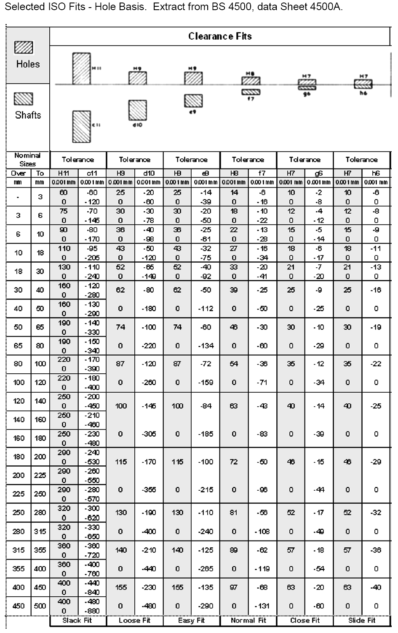

Slide 30
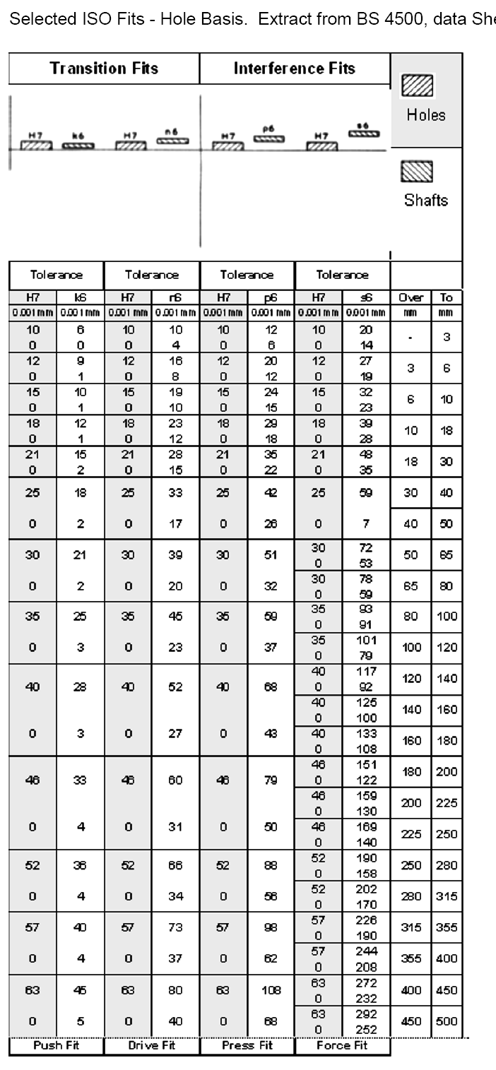

Slide 31
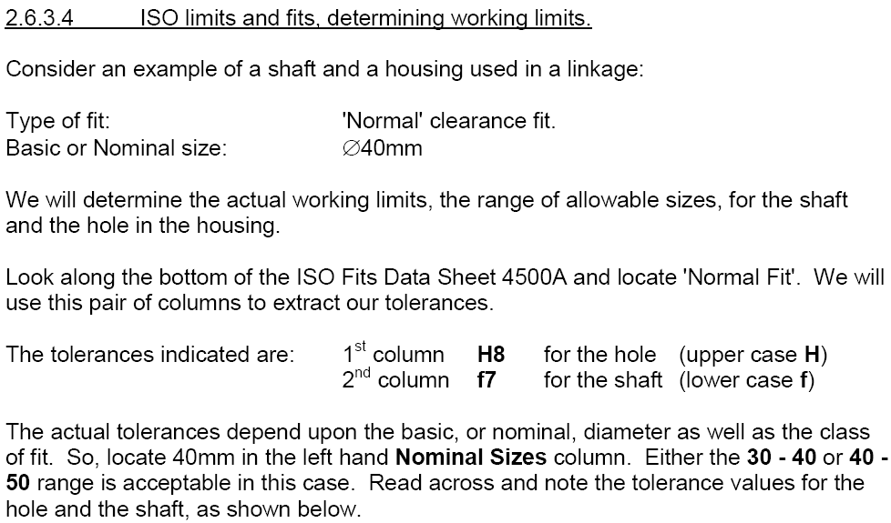

Slide 32
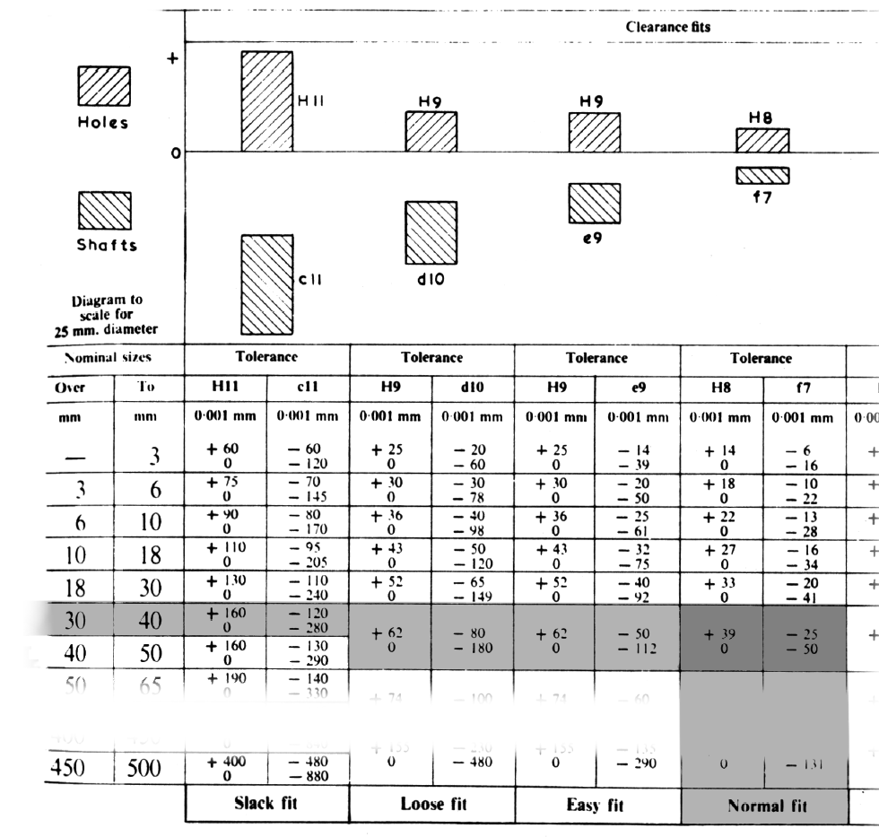

Slide 34
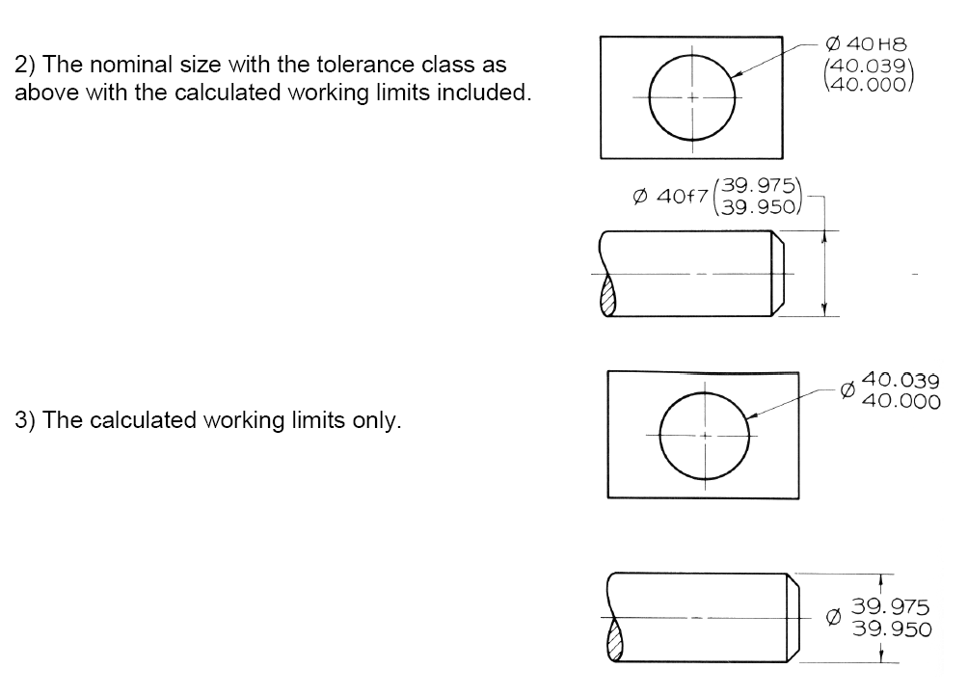

Slide 35
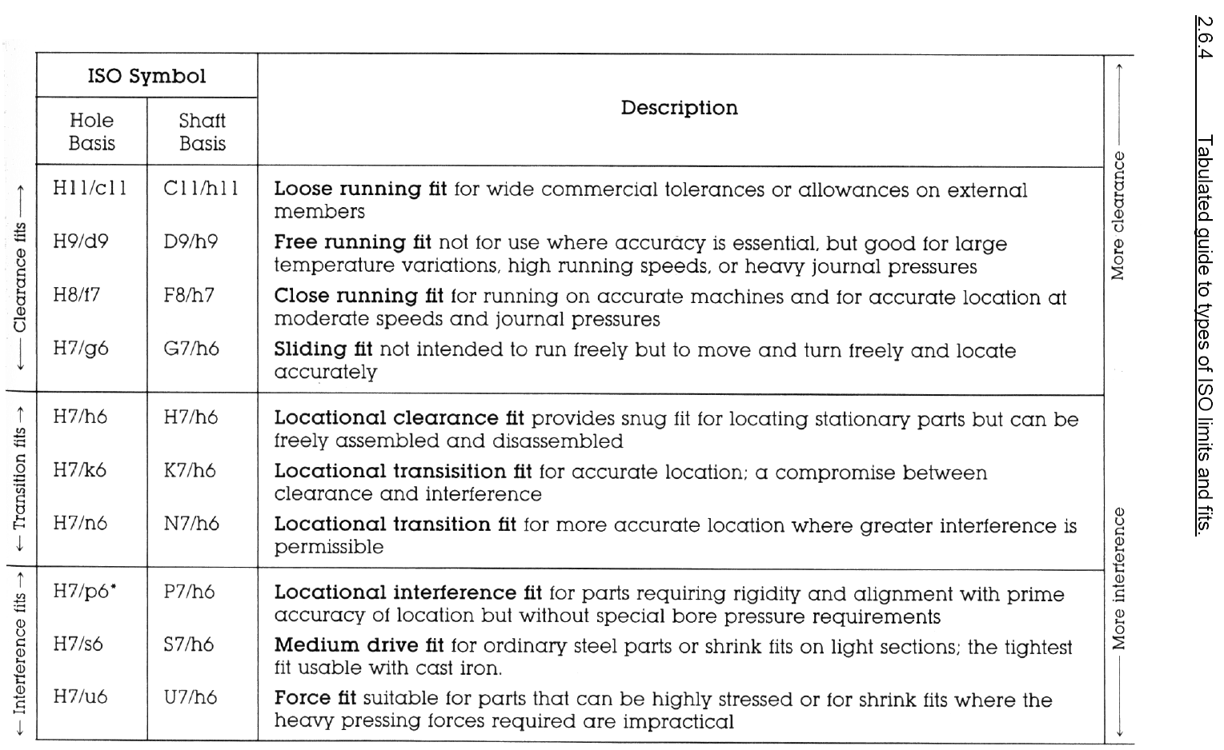

Slide 36
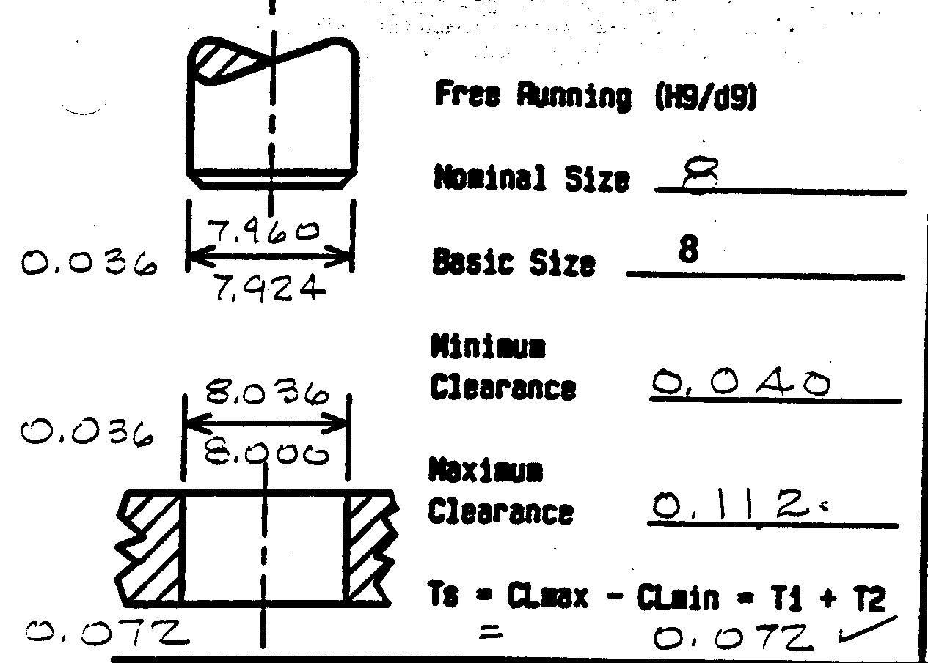
Metric Tolerance
Notes:
Instructor:
Here is an example done in the metric system.

